Slide 1
Determining sample size: some practical guidelines
Lennon Li, Tony Panzarella
Division of Biostatistics,
Dalla Lana School of Public Health

Slide 2

Not just about statistics

Slide 3
Learning Objectives
At the end of this session, you should be able to:
Explain the concepts and methodology of sample size and power calculation
Describe and gather the necessary information needed to calculate sample size
Perform sample size calculations using online tools and available software
Properly interpret and explain the results of a sample size or power calculation

Slide 4







Put effort into gathering all the right elements for sample size calculations

Slide 5
Study Planning
Good study planning has many aspects:
An unambiguous study question
Well defined target population
“A problem well stated is a problem half solved” Charles Kettering
Reliable measurement (measurement error)
Adequate sample size (confidence)
Population: parameters (fixed)
Sample: statistics (random)
Sample size planning
More than a single number calculation
Different designs/assumptions
Proper selection of samples (bias)
Good sampling methods
Ideally independent and representative samples
Population
A
B

Slide 6
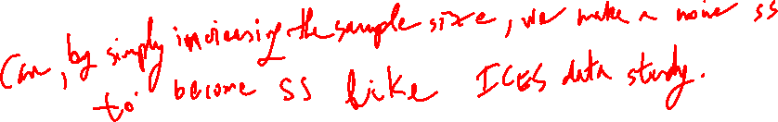
Why sample size?
Undersized studies may miss the effect of interest
Unethical to enroll subjects/spend resources in a study that is under powered, less likely to detect significance
But still could, with lower probabilities
Oversized studies are waste of resources
Unethical to expose subjects/spend resources on potentially harmful interventions or treatments
Detect statistical significance that are not of scientific interest
Approaches
Power approach: specify power of a hypothesis test (testing)
Precision approach: specify width of a confidence interval (estimation)

Slide 7
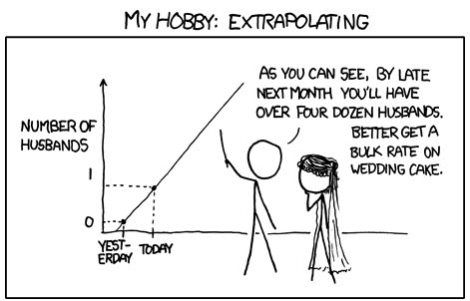
Estimation
Statistical estimation
Point estimation: estimate effect sizes,
e.g., Odds Ratio (OR) = 2.4
Interval estimation: estimate range of possible effect sizes,
e.g., 1.2-5.1
Confidence interval (C.I.) could possibly be used to make inference
Measure of confidence: width of the confidence interval
Higher confidence leads to ?
95% vs 99%?
Source: http://xkcd.com/605/

Slide 8
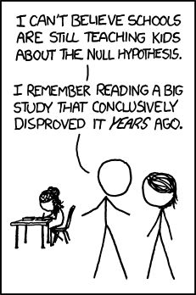
Inference
Statistical inference
Hypothesis testing
Null versus alternative hypothesis
Look for evidence against the null, conclude the alternative
Want to show something is true, disapprove otherwise
To show someone is guilty, disapprove not guilty
To show intervention is effective, disapprove intervention is not effective
Reject null hypothesis: conclude alternative
What happens if fail to reject the null
Source: http://xkcd.com/892/

Slide 9


Hypothesis testing and power
Measure of confidence: power
Only defined in hypothesis testing (not in estimation)
Probability of rejecting the null hypothesis when the null hypothesis is indeed false, P(reject H0 given H0 is false)
Similar to sensitivity….
Power is calculated under specific alternative hypotheses
Pre-specify effect sizes to detect
For each effect size, there is one power
Power is probability
Inverse to frequency in repeated studies
Good studies need high power, obviously
What does 80% power mean?
Could still fail to detect significance

Slide 10
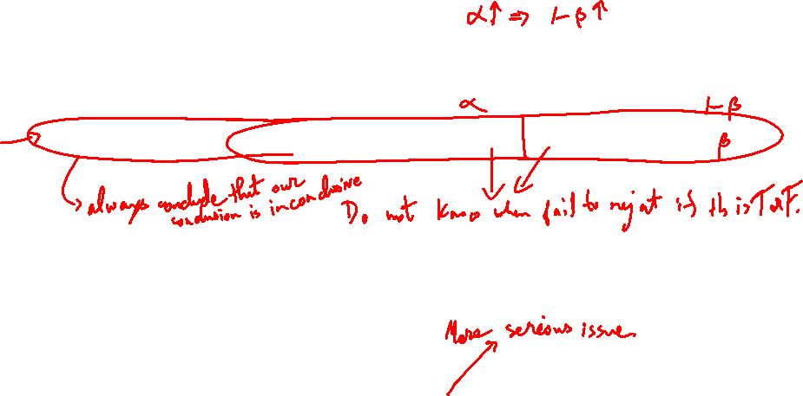
Errors in hypothesis testing
Truth | H0 TRUE | H0 FALSE
Decision: Reject | Type I error | Power
Decision: Fail to reject |  | Type II error
Total | 1 | 1
Level of significance versus Type I error
Decision rule: reject Null hypothesis if P < α , level of significance
As a result, by chance, we could have rejected it wrongly α% of the time
Example: null hypothesis is “healthy”
Truth | Guilty | Not Guilty
Reject guilty | Type I error | Power
Fail to reject guilty |  | Type II error
What is the power if null is always rejected/not rejected?

Slide 11
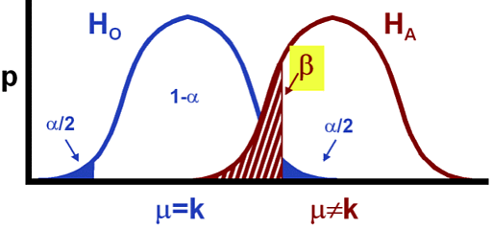
What is related to power?
Type II error (20%) β: P(fail to reject | False) = 1-power (80%)
Public health and regulation: 10%
Type I error: α ↑, power ↑
Level of significance (5%): P(reject | TRUE), false positive
Variation of the population data: σ ↓, power ↑
Effect size: δ ↑ power ↑
Difference to be detected, scientifically important
Sample size: n ↑ power ↑
Confidence ↑

Slide 12

Example: cohort study
Small sample |  | Became ill
 |  | Yes | Total | P
Ate oysters | Yes | 3 | 5 | 3/5=0.6
 | No | 2 | 5 | 2/5=0.4
 | Total | 5 | 10 | 5/10 = 0.5
Relative Risk (RR) =1.5
95% CI: 0.41-5.45
H₀: RR = 1, p=1, Power=?

Slide 13
Medium sample |  | Yes | Total | P
Ate oysters | Yes | 30 | 50 | 30/50=0.6
 | No | 20 | 50 | 20/50=0.4
 | Total | 50 | 100 | 50/100=0.5
RR=1.5, 95% CI: 0.99-2.25, p=0.071, Power=?
Large sample |  | Yes | Total | P
Ate oysters | Yes | 300 | 500 | 300/500=0.6
 | No | 200 | 500 | 200/500=0.4
 | Total | 500 | 1000 | 500/1000=0.5
RR=1.5, 95% CI: 1.32-1.71, p<0.001, Power=?

Slide 14

Questions?

Slide 15
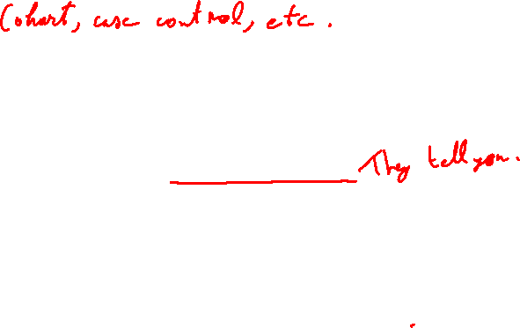
Elements of power approach
Study question and population
Study design
Statistical model and hypothesis
Type I error: 5%? This is an arbitrary number
Level of significance, R.A. Fisher, how about 1 out of 20?
Effect size of scientific interest: content expert
“what do you recommend?”, “Any difference would be important”
Power: 80%? Minimum, 90% for public health?
Other parameter estimates (e.g., variance)
Usually a series of calculations instead of a single number

Slide 16
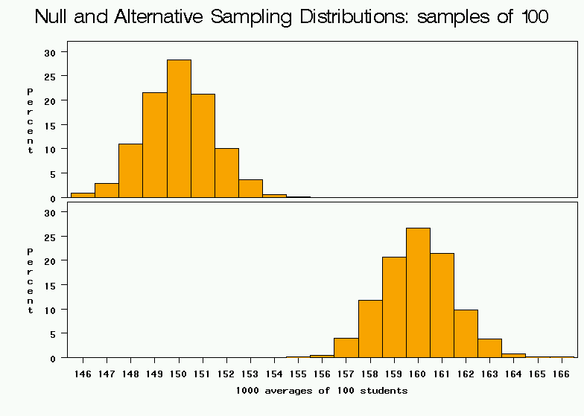

Bigger effect size
Null
Clinically relevant alternative
average weight from samples of 100

Slide 17
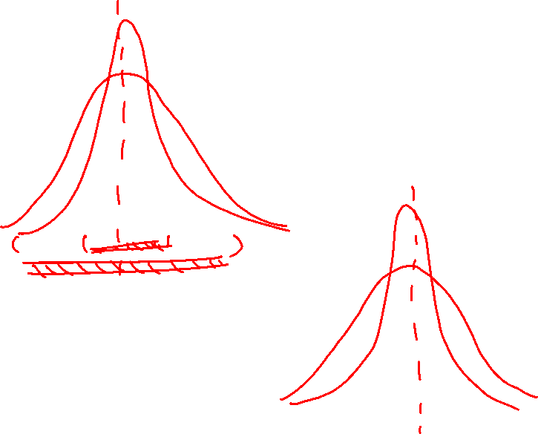
Larger variance
average weight from samples of 100

Slide 18
Higher significance level
Rejection region.
average weight from samples of 100

Slide 19
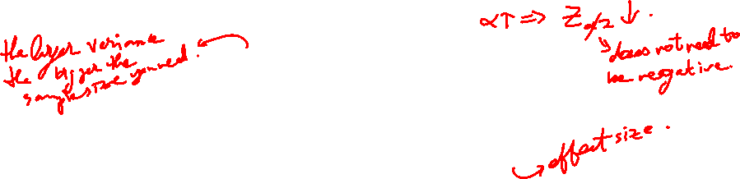
Difference in means
Represents the desired power (typically .84 for 80% power).
Sample size in each group (assumes equal sized groups)
Represents the desired level of statistical significance (typically 1.96).
Standard deviation of the outcome variable
Effect Size (the difference in means)

Slide 20
Difference in proportions
Represents the desired power (typically .84 for 80% power).
Sample size in each group (assumes equal sized groups)
Represents the desired level of statistical significance (typically 1.96).
A measure of variability (similar to standard deviation)
Effect Size (the difference in proportions)

Slide 21
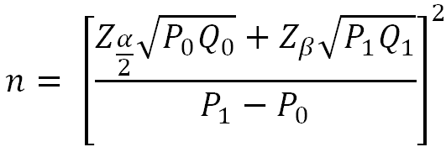
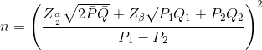
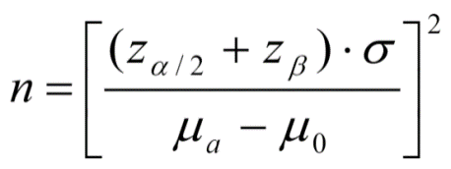
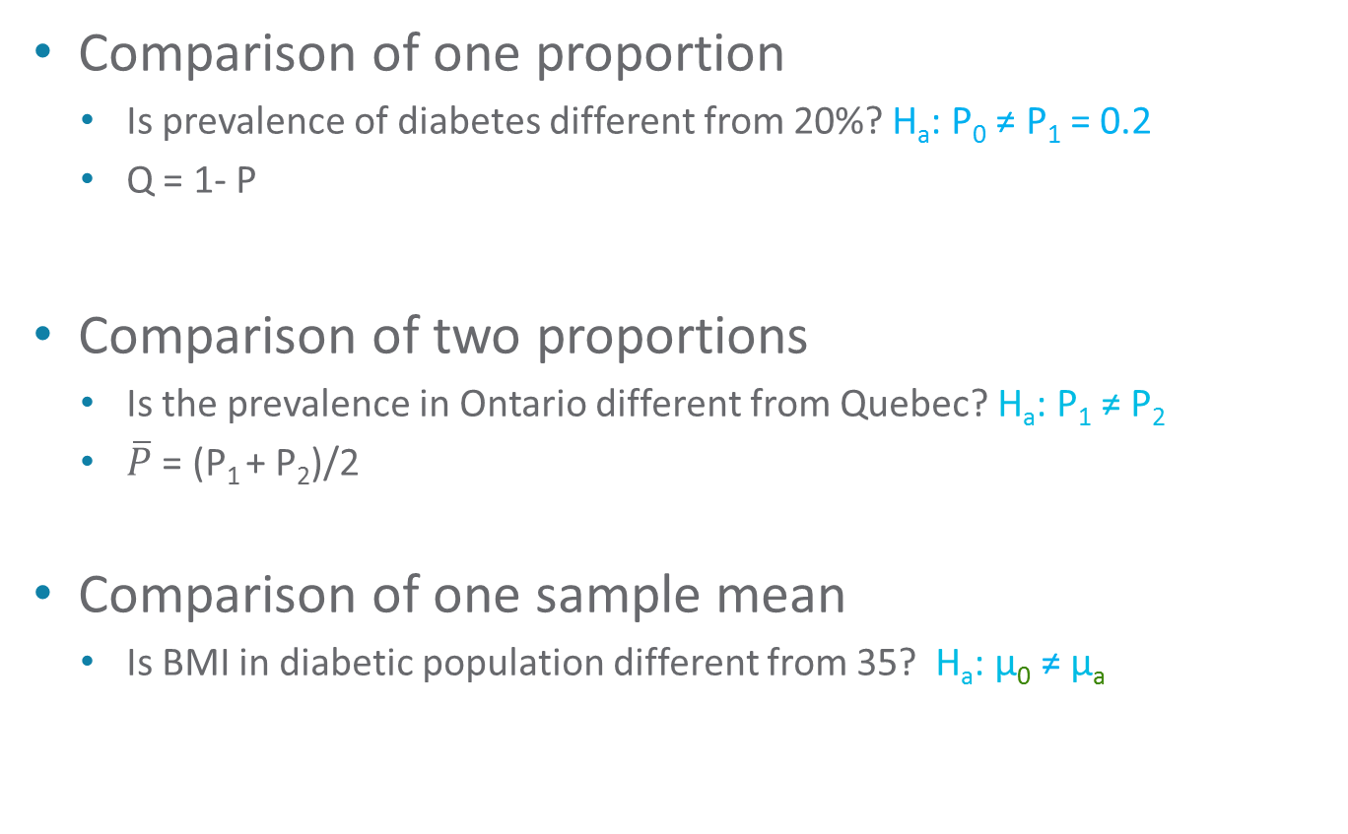
Commonly used models
Comparison of one proportion
Is prevalence of diabetes different from 20%? H_{a}: P₀ ≠ P₁ = 0.2
Q = 1- P
Comparison of two proportions
Is the prevalence in Ontario different from Quebec? H_{a}: P₁ ≠ P₂
$\overline{P}$ = (P₁ + P₂)/2
Comparison of one sample mean
Is BMI in diabetic population different from 35? H_{a}: μ₀ ≠ μ_{a}

Slide 22
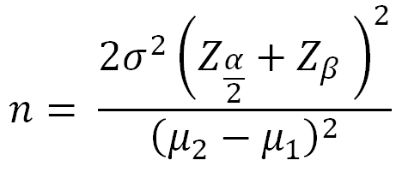
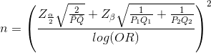
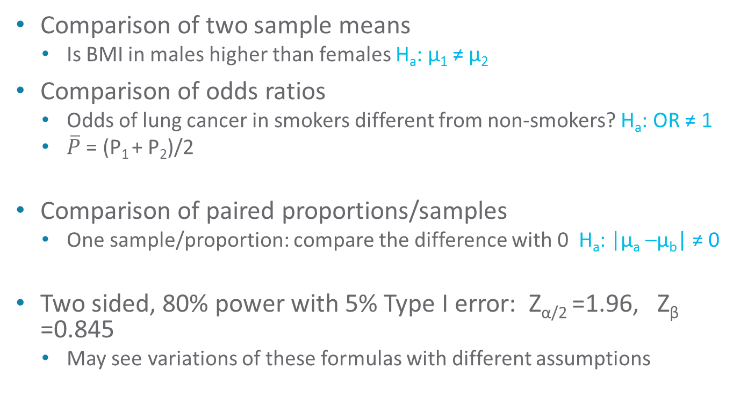
Commonly used models
Comparison of two sample means
Is BMI in males higher than females H_{a}: μ₁ ≠ μ₂
Comparison of odds ratios
Odds of lung cancer in smokers different from non-smokers? H_{a}: OR ≠ 1
$\overline{P}$ = (P₁ + P₂)/2
Comparison of paired proportions/samples
One sample/proportion: compare the difference with 0 H_{a}: |μ_{a} –μ_{b}| ≠ 0
Two sided, 80% power with 5% Type I error: Z_{α/2} =1.96, Z_{β} =0.845
May see variations of these formulas with different assumptions

Slide 23
Effect Size and Variance
It is not the job of the statistician to decide on these
But to get this information from the content expert
This should not be the estimated effect sizes from published papers
Researchers often don’t know what is being asked of them – lost in statistical jargon
Communications are important
How big is the difference could be meaningful? (clinical significance)
What is the range of clinical indifference?
Estimate of Variance
Data from the literature
Pilot study

Slide 24
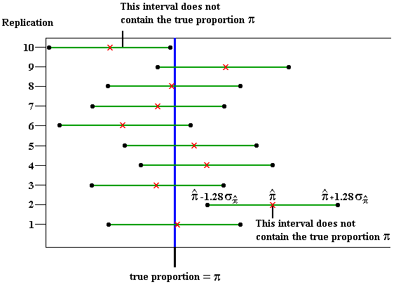
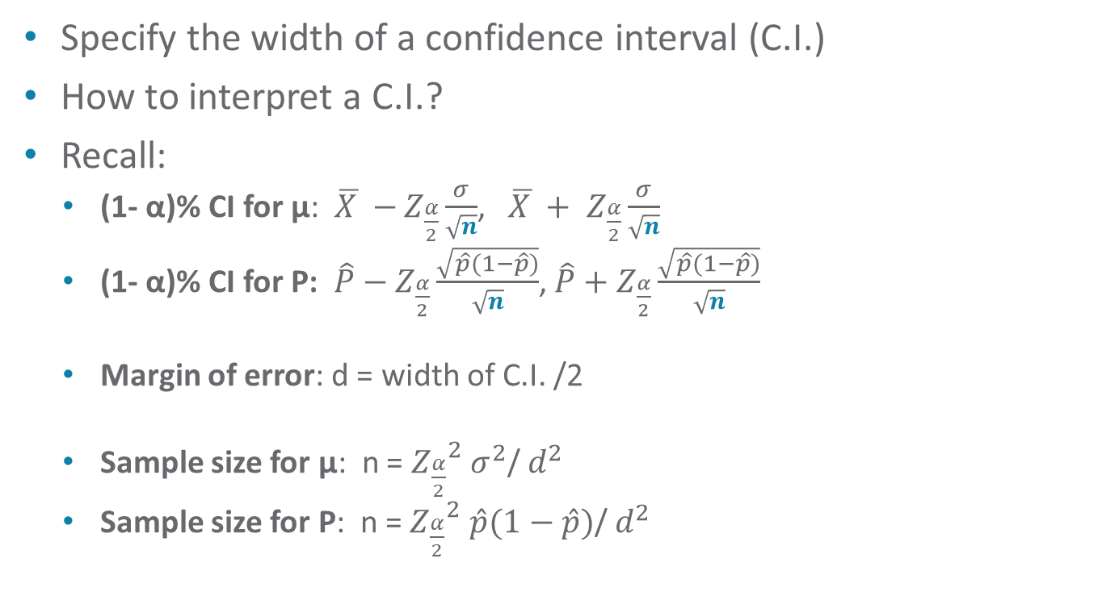
Precision Approach: interval estimation
Specify the width of a confidence interval (C.I.)
How to interpret a C.I.?
Recall:
(1- α)% CI for μ: $\overline{X }−$ $Z_{\frac{α}{2}}\frac{σ}{\sqrt{n}}$, $\overline{X }+$ $Z_{\frac{α}{2}}\frac{σ}{\sqrt{n}}$
(1- α)% CI for P: $\hat{P}−$ $Z_{\frac{α}{2}}\frac{\sqrt{\hat{p}(1−\hat{p})}}{\sqrt{n}}$, $\hat{P}+$ $Z_{\frac{α}{2}}\frac{\sqrt{\hat{p}(1−\hat{p})}}{\sqrt{n}}$
Margin of error: d = width of C.I. /2
Sample size for μ: n = ${Z_{\frac{α}{2}}}^{2}$ $σ^{2}$/ $d^{2}$
Sample size for P: n = ${Z_{\frac{α}{2}}}^{2}$ $\hat{p}(1−\hat{p})$/ $d^{2}$

Slide 25
Questions?

Slide 26
Simulations: the ultimate tool
Analysis process
Set up hypothesis and choose statistical models
Suppose you have data of size N
Carry out estimation and/or inference
Calculate effect sizes and/or p values, make a decision
Repeat
Where is data?
Simulation methods
Simulate data as “real” as possible when alternative hypothesis is true
Need information on distribution of the data
Need alternative hypothesis e.g., effect size
Formulas are available (as shown previously) with the right distribution assumption

Slide 27
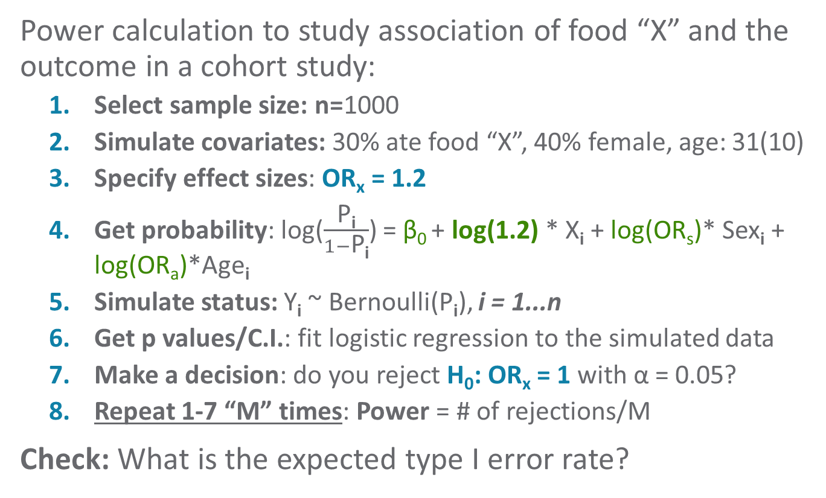


A simulation example
Power calculation to study association of food “X” and the outcome in a cohort study:
Select sample size: n=1000
Simulate covariates: 30% ate food “X”, 40% female, age: 31(10)
Specify effect sizes: OR_{x} = 1.2
Get probability: log($\frac{\text{P}\text{i}}{1−\text{P}\text{i}}$) = β₀ + log(1.2) * X_{i} + log(OR_{s})* Sex_{i} + log(OR_{a})*Age_{i}
Simulate status: Y_{i} ~ Bernoulli(P_{i}), i = 1...n
Get p values/C.I.: fit logistic regression to the simulated data
Make a decision: do you reject H₀: OR_{x} = 1 with α = 0.05?
Repeat 1-7 “M” times: Power = # of rejections/M
Check: What is the expected type I error rate?

Slide 28

Sample size for clustered data
What is clustered data?
Observations are correlated
Repeated measures, samples taken from individuals from same household
Intra-class Correlation Coefficient (ICC)
Measure of the similarity of (within) clustered data: rho – ρ.
ICC: ρ = Between cluster variability/(Within + Between)
0<ICC <=1, with 0 means no correlation
Design effect (DE)
1+(n-1)ρ
n = average cluster size
Effective sample size (ESS)
ESS= n*k/DE = Number of obs in a cluster * number of cluster/DE
N = n*k = ESS*DE

Slide 29
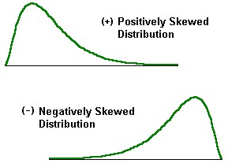
Methods for non-normally distributed data
Non-normally distributed data
Other distributions, e.g., Poisson, could be modeled with fixed number of parameters
Distribution free, i.e., do not follow a known probability distribution
Methods based on ranks of data, e.g.,
Two sample T: Mann-Whitney
Paired T: Wilcoxon signed-rank

Slide 30
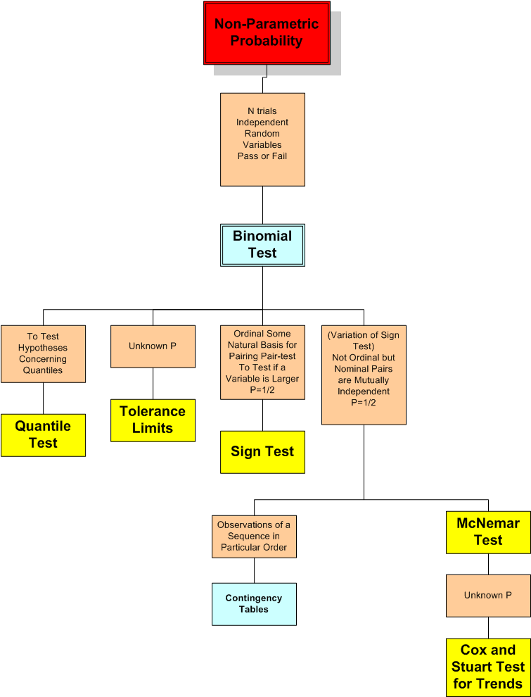
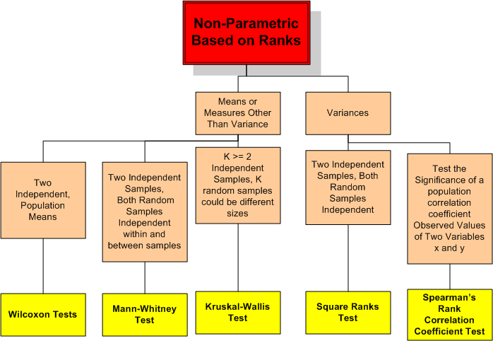
Methods for non-normally distributed data
Reference: http://www.westbrookstevens.com/using_excel.htm

Slide 31

Methods for non-normally distributed data
Parametric versus non-parametric methods
Buy information with assumptions
Power and robustness
Does it need to be non parametric?
Simulation methods for sample size calculations
Simulate data with a certain sample size N
Need distribution assumption to simulate
Analyze simulated data with non parametric methods
Make decision
Repeat above steps many times to calculate power

Slide 32
Sampling from finite population
Sample size calculations assume sampling from a huge population
Sample with replacement
What if population is small?
Make inference on particular group of people at particular time
Sample without replacement
Population size: N, sample size: n
Finite Population Correction factor (FPC) for variance
FPC = (N-n)/(N-1)
FPC = 1 of N>>>n, otherwise FPC < 1
Arbitrary rule: n/N > 0.05

Slide 33
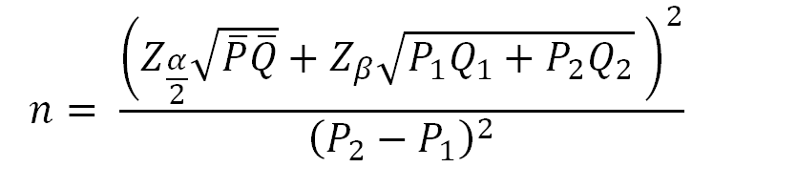

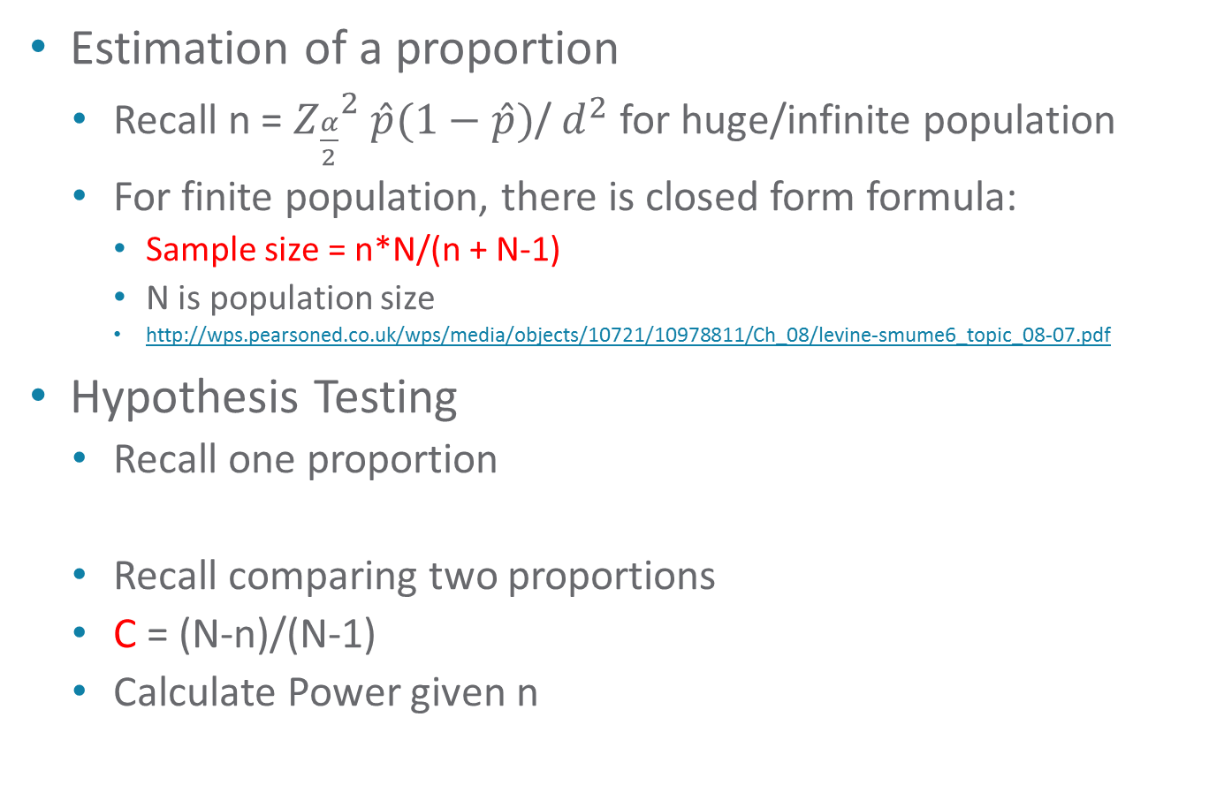




Sampling from finite population
Estimation of a proportion
Recall n = ${Z_{\frac{α}{2}}}^{2}$ $\hat{p}(1−\hat{p})$/ $d^{2}$ for huge/infinite population
For finite population, there is closed form formula:
Sample size = n*N/(n + N-1)
N is population size
http://wps.pearsoned.co.uk/wps/media/objects/10721/10978811/Ch_08/levine-smume6_topic_08-07.pdf
Hypothesis Testing
Recall one proportion
Recall comparing two proportions
C = (N-n)/(N-1)
Calculate Power given n
$$∁$$
$$∁$$
$$∁$$
$$∁$$
$$∁$$

Slide 34



What if I can not afford enough samples?
Nike
Just do it!
Low power: put science into gambling
Spiderman
Networking with avengers
Multi-center study to gain power
Terminator
Sample size too big
Terminate the project
Save time & money
I will be back!

Slide 35
Questions?

Slide 36

To keep in mind…
Use power for planning future studies
Put science before statistics
Pre-specify effect sizes that are scientifically or clinically important, then think about statistical significance
Stein: “A difference to be a difference must make a difference”
Do pilot studies or literature reviews
Help with parameter estimates
“A previous study in this area recruited 150 subjects and found highly significant results (p=0.014), and therefore a similar sample size should be sufficient here”, not valid
“A previous study in this area found an effect size of 1.85” which will be used as the effect size for sample size calculation, not valid

Slide 37
To keep in mind…
More than one hypothesis?
Adjust for multiple comparisons
Have all population data?
No statistics needed
Common approach
Calculate power for given sample sizes
A series of multiple calculations
Some quotes:
Garbage in, garbage out
“An approximate answer to the right problem is worth a good deal more than an exact answer to an approximate problem” John Tukey
“All models are wrong, but some are useful”, George Box

Slide 38
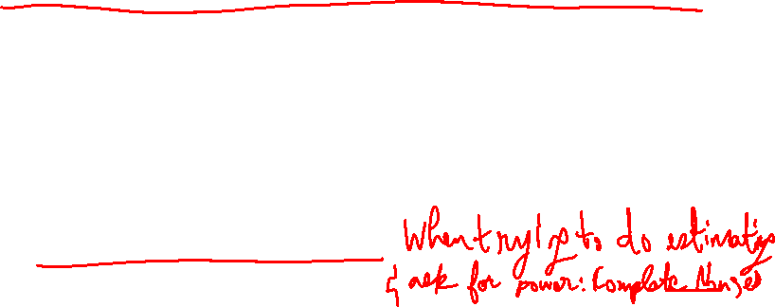
To avoid
Unit free effect sizes
0.2 small, 0.5 medium, 0.8 big…use scientific knowledge
Last minute consultation
Deadline tomorrow, I want to know if 20 subjects are enough….
“At least 10 subjects for every variable investigated”
Numerical stability, not power! no general justification
Sensitivity versus power
Property of tests/algorithms for detecting diseases or abnormal events
Not directly related to sample size
No hypothesis testing, no power

Slide 39
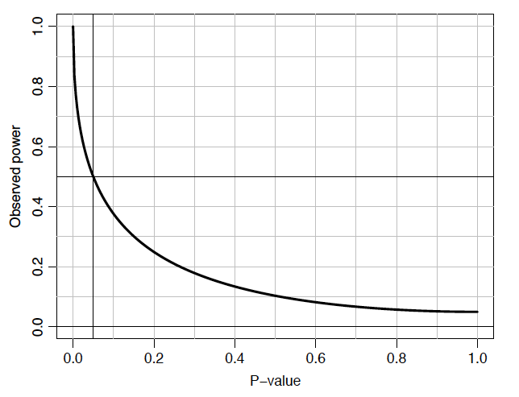

“Post-hoc power? Don’t do it!”
Compute power retrospectively to see if study is powerful
Is it because we don’t have “enough” power/samples? Always!
What was the power of this analysis? NOT valid!
Probability after the fact:
Rejected: 1; failed to reject: 0
“adds nothing to the interpretation”
What if you are asked to do it?
Refuse & cite references
For any study

Slide 40
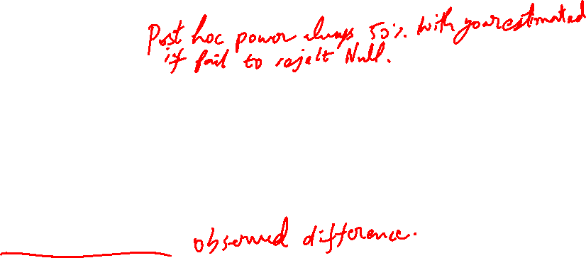
Post-hoc power example
Design stage
Medical treatment has a cure rate of 45%
Surgical procedure proposed – given morbidity a 70% cure rate sought to justify use
90% power to “detect” a 25% difference between 2 treatments with n=80 in each group
Observed data
Cure rate of 60/80 (75%) in surgical
49/80 (61%) in the original
14% difference; P=0.06; 95% CI (-1% to 29%)
Power of observed difference is ?

Slide 41
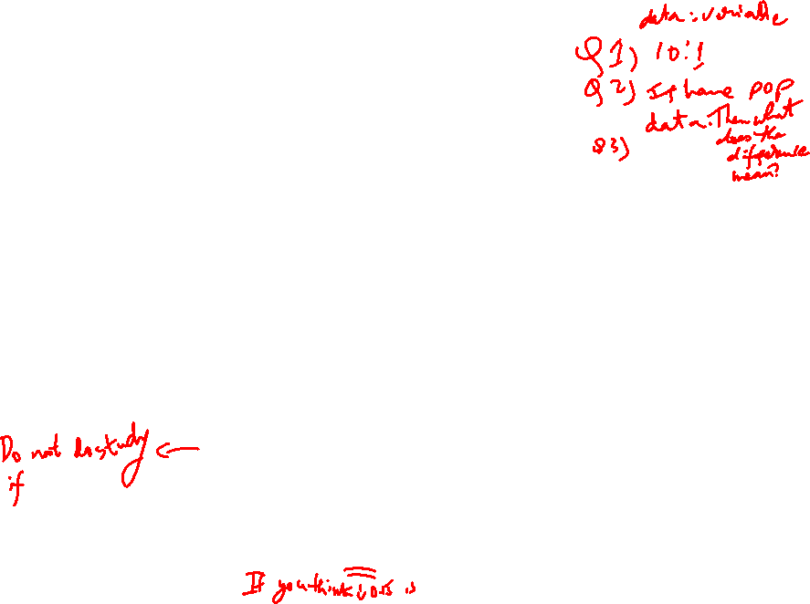
Post-hoc power (PASS 15)

Slide 42
Questions?

Slide 43
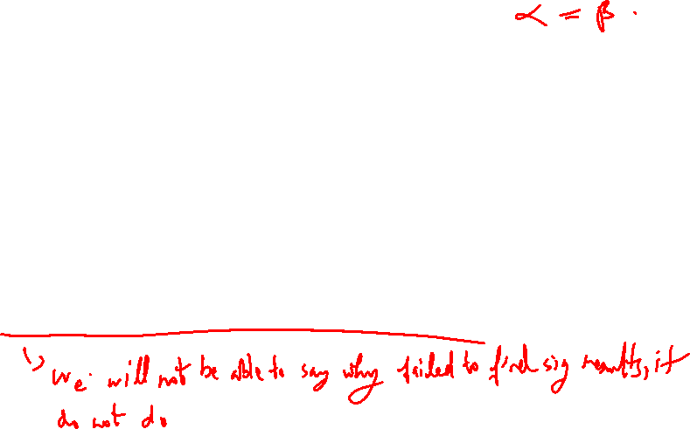
Revisit: what we’ve learned
Why are sample size calculations important?
What are necessary for a sample size calculation?
How to do a sample size calculation? (the easiest part…)
How should sample size calculation results be interpreted?
What does it mean if not enough samples can be collected?
What does an insignificant study/result mean?

Slide 44

Some sample size tools
Freeware:
Web based sample size calculators
Epi Sheet http://www.krothman.org/Episheet.xls
Epi Data http://www.epidata.dk/
Open Epi http://www.openepi.com/Menu/OE_Menu.htm
G*Power:
http://www.psycho.uni-duesseldorf.de/abteilungen/aap/gpower3/
Epi Info:
http://wwwn.cdc.gov/epiinfo/
With add on packages

Slide 45
Commercial software
SPSS (Sample Power 3)
Very limited
https://www.youtube.com/watch?v=yUnHatmPsYU
http://www-03.ibm.com/software/products/en/spss-samplepower/
STATA 13
http://www.stata.com/manuals13/pss.pdf
https://www.youtube.com/watch?v=szNkh8Z7Op8
https://www.youtube.com/watch?v=QBONLUp7i28
PASS http://www.ncss.com/pass_procedures.html
SAS (with graphic user interface)

Slide 46
References and Resources
Hoening JM, Heisey DM. The abuse of power: the pervasive fallacy of power calculations for data analysis. The American Statistician. 55(1):19–24; 2001.
Lenth, RV. Some practical guidelines for effective sample-size determination http://www.stat.uiowa.edu/~rlenth/Power/ and http://www.stat.uiowa.edu/techrep/tr303.pdf
Boen JR and Zahn DA (1982) The Human side of statistical consulting, Lifetime learning publications, Belmont, CA.
Cohen J (1988) Statistical power Analysis for the Behavioral Sciences, Academic press, New York, 2nd ed.
Hahn P. Sample size estimation http://meds.queensu.ca/medicine/obgyn/scholar/Sample%20size%20estimation_p.pdf
Goodman SN and Berlin JA (1994) The use of predicted confidence intervals when planning experiments and the misuse of power when interpreting results Ann Intern Med; 121:200-206
Some online calculators
http://www.stat.uiowa.edu/~rlenth/Power/
http://www.stattools.net/SSiz1prop_Pgm.php
http://stat.ubc.ca/~rollin/stats/ssize/caco.html
http://www.jerrydallal.com/LHSP/SIZE.HTM
http://biostat.mc.vanderbilt.edu/twiki/bin/view/Main/PowerSampleSize

Slide 47
Summary
Questions to think about before a calculation
Estimation or inference?
How do you measure the outcome?
What is the distribution of the data?
Which statistical method to analyze the data?
Sampling from finite population?
Will the data be correlated?
Other information…
Pick the right tool
Know you tool: every tool is different

Slide 48
A review
Type I and Type II error are inversely proportional
True
False

Slide 49
A review
Larger the sample size leads to more useful findings
True
False

Slide 50
A review
Which of the following statement is not true?
The power of a non-significant difference will always be < 50%
Sample size is inversely proportional to the effect size
A power of 95% should always be preferred over a power of 90%.

Slide 51
A review
Which of the following statement is not true?
It is important to determine a sample size that detects the smallest clinically significant difference
Failing to rejected the null hypothesis means there is not enough power to detect the estimated effect size
When domain experts (clinicians, epidemiologists) do not know what effect sizes to use, a rule of thumb of 5 could be used for calculations.

Slide 52
A review
Which of the following is wrong to do when you can not afford large sample size
Increase type I error rate
Increase effect size
Increase power
Give up

Slide 53
No numbers are wrong, as long as you are able to justify your choices.

